Slide 1
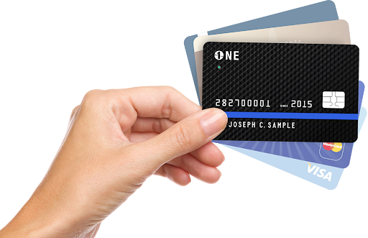
Customer Spending Analysis For Mitron Bank

Slide 2

Outline
Problem Statement
Methodology
Results
Visualization – Charts
Dashboard
Discussion
Findings & Implications
Conclusion

Slide 3

Problem StatEment
Mitron Bank is a legacy financial institution headquartered in Hyderabad. They want to introduce a new line of credit cards, aiming to broaden its product offerings and reach in the financial market.
AtliQ Data Services came to know about this through an internal link and
approached Mitron Bank with a proposal to implement this project. However, strategy director of Mitron Bank, Mr.Bashnir Rover is skeptical and asked them to do a pilot project with the sample data before handing them the full project.
They provided a sample dataset of 4000 customers across five cities on their
online spend and other details.

Slide 4

METHODOLOGY
Working on the spending analytics of customers involved dealing with the average income utilization % of customers. This is gotten by utilization % = (spend/income) * 100. This % was used as a key metric to analyze spending habits.
The dataset was classified into different categories:
1. Avg Income Classification By City, Gender and Marital Status
2. Spending Insights Classification By Payment type, Occupation, City, Age Group, Month, Gender, Marital Status and Category.
3. Demographic Classification of Customers By Gender, Marital Status, Occupation, City and Age Group
4. Avg_income utilzation % by city and by occupation

Slide 5

INSIGHTS
Insights on the spending analytics of customers involved dealing with the average income utilization % of customers. This is gotten by utilization % = (spend/income) * 100. This % was used as a key metric to analyze spending habits.
The dataset was classified into different categories:
1. Avg Income Classification By City, Gender and Marital Status
2. Spending Insights Classification By Payment type, Occupation, City, Age Group, Month, Gender, Marital Status and Category.
3. Demographic Classification of Customers By Gender, Marital Status, Occupation, City and Age Group
4. Avg_income utilzation % by city and by occupation

Slide 6
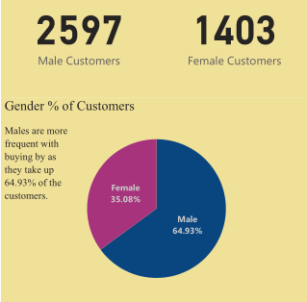
Demography Insights
The Total Number of Customers is 4000 of which 2597 are Males and 1403 are Females, meaning males make up 64.93% of customers while females make up 35.08%.
From the 4000 customers, 78.4% (3136) are married, while 21.6% (864) are single.
For City the highest number of customers come from Mumbai (1080 customers), followed by Chennai (830 customers).
For Occupation the highest number of customers come from Salaried IT Employees (1290 customers), followed by Salaried Other Employees (890 customers).
For Age Group the highest number of customers come from the younger age group 25-34 (1500 customers), followed by 35-45 (1270 customers).

Slide 7
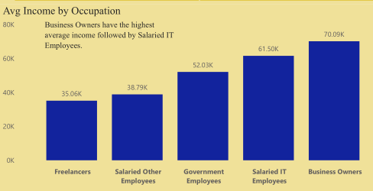
Average INcome Insights
For Occupation, Business owners have the highest average income of above #70K, followed by Salaried IT Employees of avg income above #61K
For Gender, Males have a slightly higher total average of #51.7K income compared to females of average income of #51.63K
For Marital Status, Married people have a higher total average income of above #53K compared to singles of average income of above #43K

Slide 8
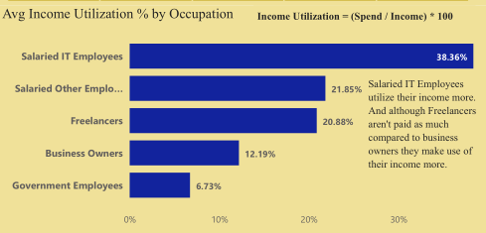
Average Income UTilization % Insights
This refers to the % of income used on expenses
For Occupation, Salaried IT Employees who are the 2nd highest average income earners have the highest income utilization of 38.36%. Hence they spend more. This is followed by Salaried other employees of 21.85% utilization.
Surprisingly Business owners who are the Top average income earners have a 12.19% utilization but when compared to the total spend, they have a high total spend regardless of the utilization %
Freelancers dont earn as much as business owners on average, but they have a high utilization of 20.88%, but low total spend
For City, Mumbai is the city with the highest income utilization of 32.36%, they also have the highest average income earners and is the city with the highest number of customers. This is followed by Delhi with a 20.88% utilization.

Slide 9
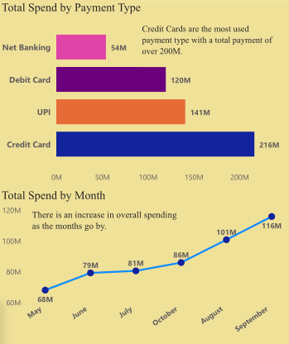
Spending Insights
For Payment type, The most used payment type is credit card with a total spend of over #200 Million processed through it. This is followed by UPI payment type.
For Occupation, Salaried IT employees spend more with a total spend of #244 Million, of which majority of it was processed using Credit Card. This is followed by Business Owners with a processed spend of above #88 Million.
For City, Mumbai, The city with the highest average income earners and highest number of customers came out as usual as the city with the highest number of processed spends of above #172 Million, again of which most was done with the Credit Card. This is followed by Delhi with processed spends of #111 Million.

Slide 10
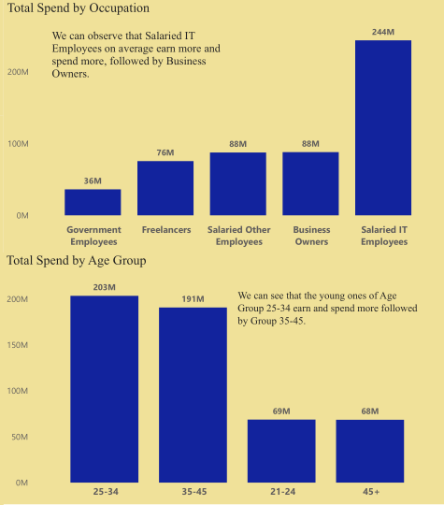
Spending Insights
For Age Group, 25-34 ages have the highest number of processed spends of #203 Million, followed by group 35-45 of #191 Million processed spends. The older age group of 45+ have the lowest number of processed spends of #68 Million.
For Month, we see an increase in overall total spend as the months go by, with September being the highest with a total spend of #116 Million.
For Category, The highest total spend was on Bills, followed by the priority to eat which is on groceries, then electronics. Again with Credit card being the most used payment type.

Slide 11
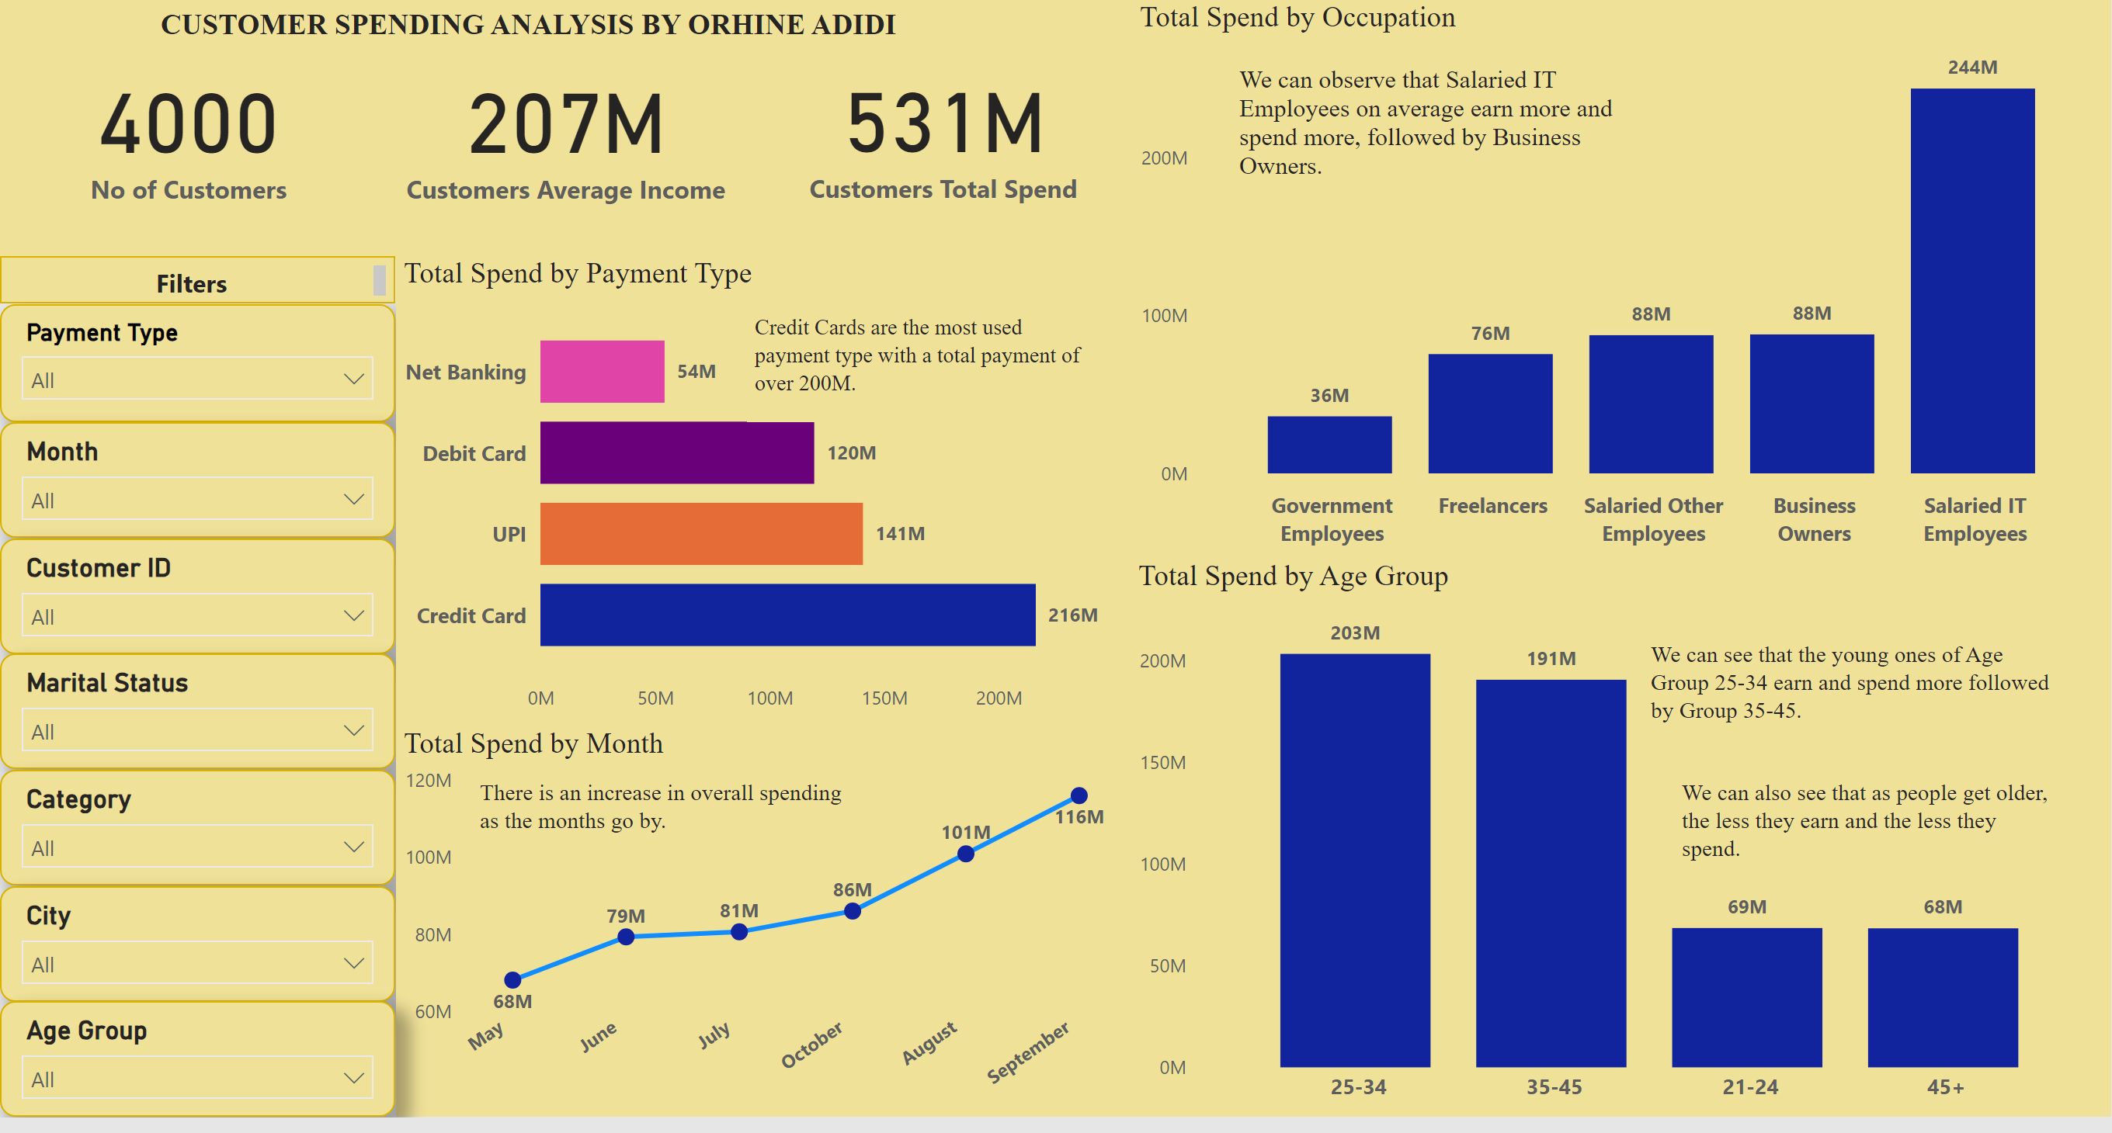
DASHBOARD – KEY INSIGHTS

Slide 12
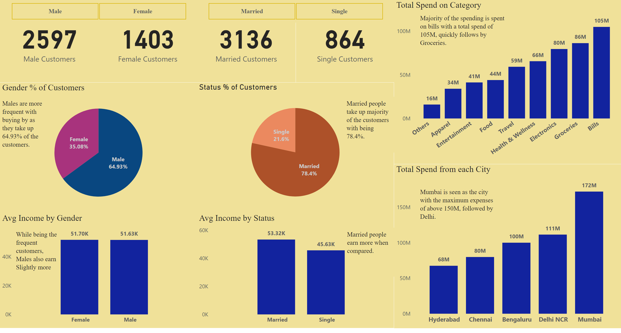
DASHBOARD – KEY INSIGHTS 2

Slide 13
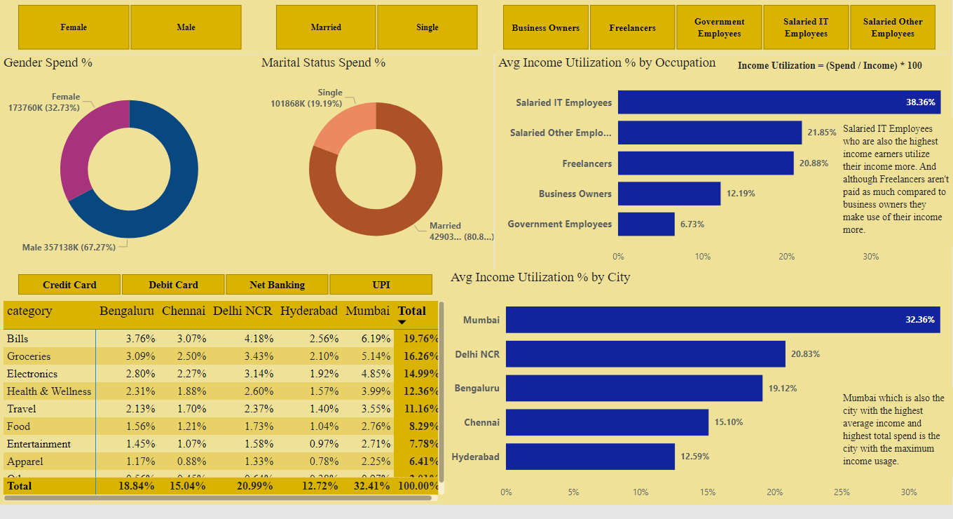
DASHBOARD – SPEND INSIGHTS

Slide 14
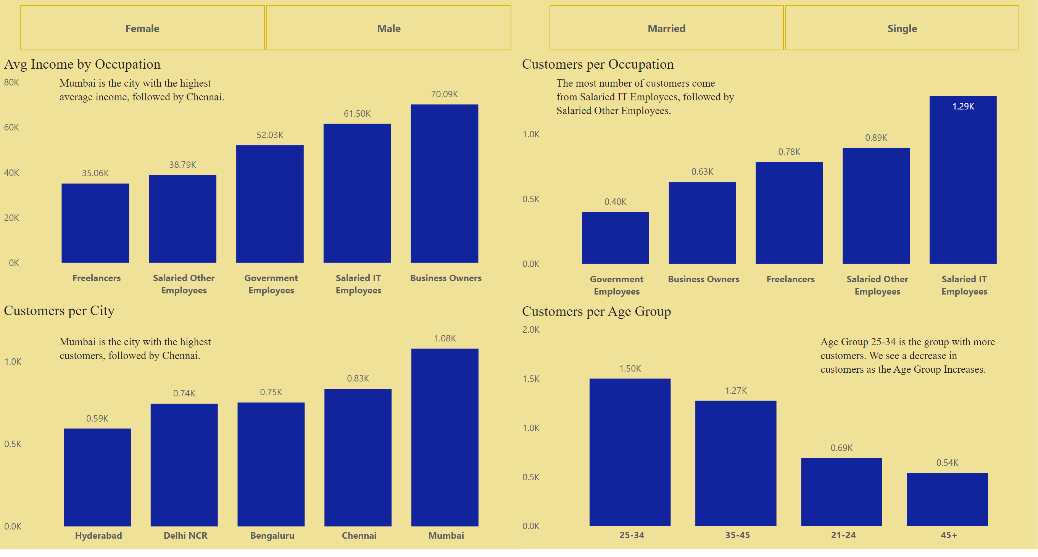
DASHBOARD – DEMOGRAPHIC INSIGHTS

Slide 15

Discussion
The Live Dashboard provided can be used to filter certain information in order to gain more insights with respect to the filter. For example, Customer ID filter is present and can be used to filter the total spend for each customer, their average pay and in which month they spend more.
For the purpose of this project analysis my focus is on Credit Cards.
Credit Card being the most used payment type across all demographics and spending areas, this gives Mitron Bank a good advantage for the launch of theirs.
Credit cards are used more age within groups 25-34
Credit cards are used more by Salaried IT Employees
Credit cards are used more in Mumbai
Credit cards are used more to settle bills and pay groceries at the store

Slide 16
Discussion
But in order for customers to choose Mitron Banks Card I would recommend that they:
Offer better maintenance rate on their cards. This can make more people pick up the use of the new card.
Introduce welcome offers for registering a new card.
Introduce a rewards-earning rate for their cards.
Pick up an Annual Percentage Rate for amount of money in their card yearly.
Introduce a benefit for business owners and salaried IT employees as they constitute the highest spenders.
Introduce a discount for payment on the bills and groceries category as they constitute the category that are spent on more.

Slide 17

CONCLUSION
In conclusion Mitron Bank going for new credit cards is a nice idea as majority of people already make use of it for their payment. But to stand out from their competitors I would advice they follow the six recommendations I have discussed to gain an edge in the market.

